Slide 1
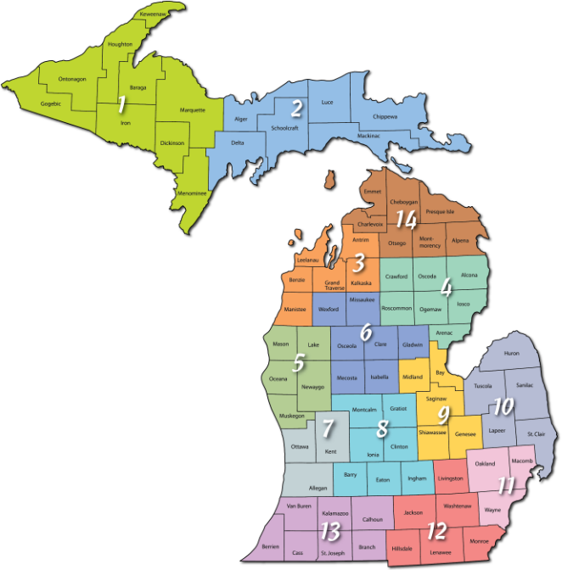
Strengthening Research Projects through Partnerships with MSU Extension
Erica Tobe, PhD.
Michigan State University Extension
Children and Youth Institute
tobee@msu.edu

Slide 2
Who is MSUE?
Statewide health delivery system
Business start-up, tech transfer and product development expertise (Product Center)
Reach every school system in the state; 200,000+ youth in 4-H; 20,000+ adult volunteers
Experts throughout entire State for 100 years
Rapid response for agriculture, human health and other emergencies – e.g., Flint
Future funding growth from philanthropy, partnerships and competitive external funding

Slide 3
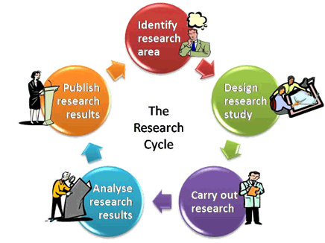
Extension as a part of the research cycle
Identifying community information needs
Developing outreach/engagement plans
Connection to partners, participants, etc.
Recruitment
Into studies
Focus groups
Clinical Trials
Citizen Science (volunteer recruitment and training)
Evaluation of Outreach efforts
Development and delivery of curricula, trainings, tools and resources

